Slide 1
COMPUTER PRINCIPLES FOR PROGRAMMERS
File Compression,
3-2-1 Backup with 4QFeybBPWkeiOg==
Notes:
Backup with encryption

Slide 2


News of the Week

Slide 3
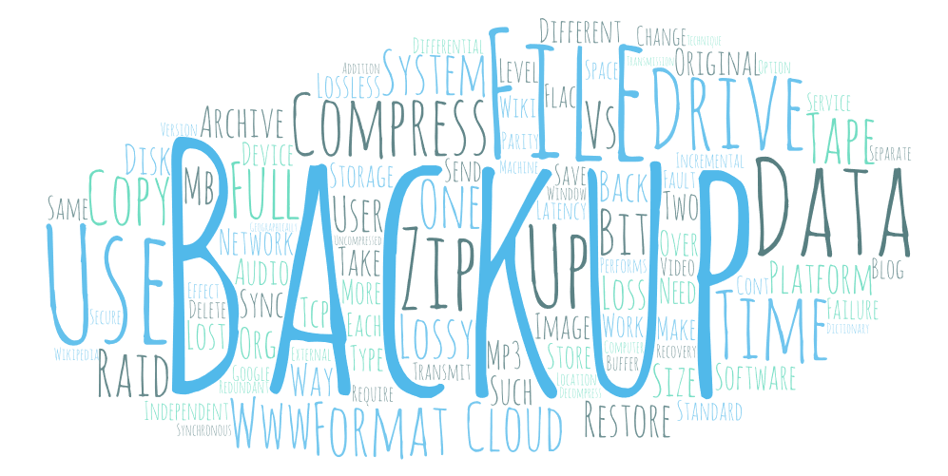
Notes:
Today's agenda. Word cloud generated from this slide deck.

Slide 4

Agenda
Lecture:
What, Why, and How of “File Compression”
… effect on data transfer
… drawbacks
… overview of formats
… Lossless vs Lossy
What, Why, and How of “Backup”
… types of backups
… backup media

Slide 5

Agenda (Cont’d)
Activity:
Explore File Compression
Compress various native file formats within a ZIP archive and compare the compression factors
Upload files to Blackboard to demonstrate a network backup

Slide 6

What is “File Compression?”
4 pink
5 green
3 blue
Notes:
Don't store redundant/repeating data.

Slide 7
What is “File Compression?”
storing a file’s data in “less space”
by “minimizing redundancy” in the content
An archive is a collection of folders and files stored in one file, e.g. filename.ZIP
  Files are usually compressed
  Files can be encrypted
  Cross platform exchange
OS options to compress / encrypt local files

Slide 8
Why use File Compression?
Writing / Sending data takes bandwidth and I/O time
  Tape – not as obsolete as you might think with Linear Tape-Open
  NAS – Network Attached Storage (local or remote)
  USB – removable drives (ad hoc, user level)
  FTP or Cloud Storage AWS Glacier, Google Nearline
Encrypt off-site data for security
  compression software has a password encrypt option
SSH (Secure SHell) can compress data: asynch.
VoIP must do this in real-time, synchronously.
Streaming sends compressed, receiver decompresses.
Notes:
When files are copied to backup devices or to remote storage, you not longer have the security of physical access control. Anyone who has the physical media and a reader can see your data.
When files are sent outside your system, i.e. outside your system's security, they should be encrypted. And compressing them at the same time makes sense.
https://www.databarracks.com/blog/is-tape-backup-dead
"The total use of tape has fallen from 42% of businesses in 2008 to just 14% in 2016. use of 'cloud' backup rose from 23 to 43% over that period."
although a small percentage of companies use tape, those are BIG companies.
Be careful what you count. Instead counting businesses using tape, count shipments of tape capacity
https://www.networkworld.com/article/3315156/tape-vs-disk-storage-why-isnt-tape-dead-yet.html
"2017 saw the shipment of more than 1 million petabytes in LTO tape capacity – roughly five times what was shipped in 2008."
tape will always be cheaper than disk storage. Tape separates the medium from the recording device: a few tape drives service thousands of tapes. Tapes do not need power and cooling. Even if disk was free, it might still cost more than tape due to the power and cooling savings alone.
Linear Tape-Open (LTO) - https://en.wikipedia.org/wiki/Linear_Tape-Open
Dec. 2017 – LTOv8 cartridge capacity of 12TB raw or 30TB compressed written at 900MB/s. Special LTO Streaming Lossless Data Compression rate of 2.5:1
Cartridge size is approx. 10cm X 10cm X 2cm
https://medium.com/roxiler-systems-pvt-ltd/amazon-glacier-vs-google-nearline-107de9e3f95c
directly to tape (D2T), backing up to disk then copying to tape (D2D2T), backing up to disk with no tape component (D2D/D2D2D), or backing up to the cloud (D2C/D2D2C).
SSH, used in secure terminal and FTP sessions, has a compression option for transmission of data but it introduces latency: data must be held in a buffer to compress a chunk of it before transmission. The extra time it takes to buffer and compress the data, send/receive the compressed data, and buffer and decompress the data should be less than the time to simply transmit the longer uncompressed plain text version.
File data can arrive in various pieces and be reassembled. (IP packets may be lost, duplicated, or delivered out of order. TCP detects these problems, requests re-transmission of lost data, and rearranges out-of-order data. This preserves the integrity of the original transmission but the cost is additional latency.) Computers will wait patiently for a file to arrive completely. Sending and receiving can occur asynchronously, i.e. events that are not coordinated in time.
Digital Telephone VoIP (Voice over Internet Protocol) works in a similar way. It blocks a time frame of digitized voice, compresses the block which takes a short time to transmit, and decompress the block at the other end so it sounds like continuous speech. This is harder to do successfully than sending files. Two-way conversation must be perceived in real-time without delays, that is, it must be synchronous: events and TCP/IP packets that are coordinated in time. Call centers that save money by overly compressing voice and uploading VoIP over slow bandwidth will lose far more money than they saved as soon as the customer says, "I could not hear or understand you; please repeat."
See https://netbeez.net/blog/impact-of-packet-loss-jitter-and-latency-on-voip/
Streaming audio and video such as digital TV (sent over the air from a TV station or streamed from Netflix) or audio from Spotify, have an easier time of it because they are transmitting previously compressed data, sending as little as possible over high speed networks. Without a compression stage, latency from the sending side is reduced. The receiving side buffers the received data, decompresses it, and outputs the video/audio in real time. Because the sending side usually transmits compressed data faster than the receiving side can output decompressed video/audio, the humans perceive a smooth analog experience of uninterrupted video/audio. Critically, the receiving device has extra memory for buffering, unlike Network Interface cards which have minimal buffer storage. As long as the server and network can put data into the receiving buffer faster than the decompression software can take data out of the buffer, everyone is happy. This allows variance in overall throughput. When a streaming session begins, it often appears that the streaming service is slow – it is not. The delay is the time it takes to fill up the receiving side's buffer.

Slide 9
Effect of File Compression on Data Transfer
Assumptions:
1MB plain text file, unique for each of 30,000 users
Network throughput is 2 seconds per file
text compressed to 35% of original, throughput 1 sec/file
 | Data | Time | Size
Original 1MB plain text | 8.24 Mb | 16.6 hours | 241.4Gb
Compressed to 35% | 2.88 Mb | 8.3 hours | 84.5Gb
Notes:
Each user gets a unique, personalized file, e.g. payroll information. 1MB to 30,000 users is much slower than 30GB to one user
Network bandwidth vs throughput: think cars on the highway. If all cars in each lane travelled at the same speed, if cars merged on and off without slowing cars already on the highway, if there was no space between cars, that's bandwidth utilizing 100% of the road capacity. The only time this happens with human drivers is during a traffic jam. 100% utilization of the road but very poor throughput for any individual vehicle.
The reality is space between cars is a necessary safety margin, weather affects the speed of traffic, too much traffic causes congestion, ½ the drivers of cars on the road are incompetent: they have a low level of skill in operating a vehicle and don't follow the rules.
Plain text compression to 35% of original is a safe assumption, normal range for text is 25% to 50% of original depending on repeating patterns within data.
Compression to 35% results in ~ half the time (latency is the same, still have 30,000 separate transfers to do) but ~one third the data resulting in less network congestion.
TCP packet overhead adds ~3% to original data
Original 1MB = 1024 * 1024 = 1,048,576 + 3% TCP overhead = 1,080,033 * 8 bits = 8,640,264 = 8.24Mb
Compressed to 35% of original = 1,048,576 *.35 = 367,002 + 3% TCP overhead = 378,012 * 8 bits = 3024096 = 2.88Mb
Compression can make delivery feasible.
https://dsp.stackexchange.com/questions/3474/what-are-some-typical-lossless-compression-ratios
survey paper on compression, "A Survey Of Architectural Approaches for Data Compression in Cache and Main Memory Systems", shows that most practical techniques on general benchmarks achieve compression ratio ~2X and some up to 4X, although higher potential (e.g. ~16X in some cases) exists (see Section 2.2). The reason for not achieving full potential is that techniques with higher compression ratio also have higher overhead (e.g. extra hardware which consumes power, extra processing which takes time) or the input data has a high proportion of repeating data (e.g. compressing file with all zeros).
https://www.dnsstuff.com/network-throughput-bandwidth

Slide 10
How File Compression works
Compression combines:
matching and replacement of duplicate strings with pointers.
  Lempel–Ziv–Welch (LZW) compression (1984)
replacing symbols with new, weighted symbols based on frequency of use.
  Huffman coding (1952)
  David A. Huffman was a Ph.D student at MIT
Notes:
https://en.wikipedia.org/wiki/Data_compression
https://en.wikipedia.org/wiki/DEFLATE
Both use sophisticated mathematics, pattern matching and analysis, and add the overhead of a dictionary/table to determine how to replace the redundancies.
Are Pop Lyrics Getting More Repetitive? https://pudding.cool/2017/05/song-repetition/
visual illustration of the matching and replacement of duplicate strings with pointer, i.e. LZW compression
Load page and page/arrow down until "Measuring Repetitive Lyrics With Compression" stays at top of page, then slowly press down arrow to see annimation
Huffman coding (https://www.huffmancoding.com/my-uncle)
In order to get out of writing the final exam, David Huffman's professor gave the problem of finding the most efficient binary coding for a given set of symbols. The problem had been worked on by Huffman's professor who worked with Claude Shannon, the father of information theory and one of the greatest pioneers in computer science. Huffman's professor neglected to say that there was no obvious solution and no mathematical proof. So Huffman, not knowing it was impossible, solved the problem. His algorithm continues to be widely used.
https://www.youtube.com/watch?v=ZdooBTdW5bM (how to compress )
go to 4:30 in the video to decompress the bits at the end. Each encoded bit takes you down one branch of the tree.
For a quick encode & decode explanation, see David Esposito's mini lecture/demonstration:
https://www.youtube.com/watch?v=AqFliCFNBWI (quick review of compression)
https://www.youtube.com/watch?v=kJE5u7PFY2E (the simplicity of decoding using binary trees)
raw text: sally sells sea shells
charArray: s a l y _ e h
counterAr: 6 2 6 1 3 3 1
Frequency of unique char used to build binary tree.

Slide 11
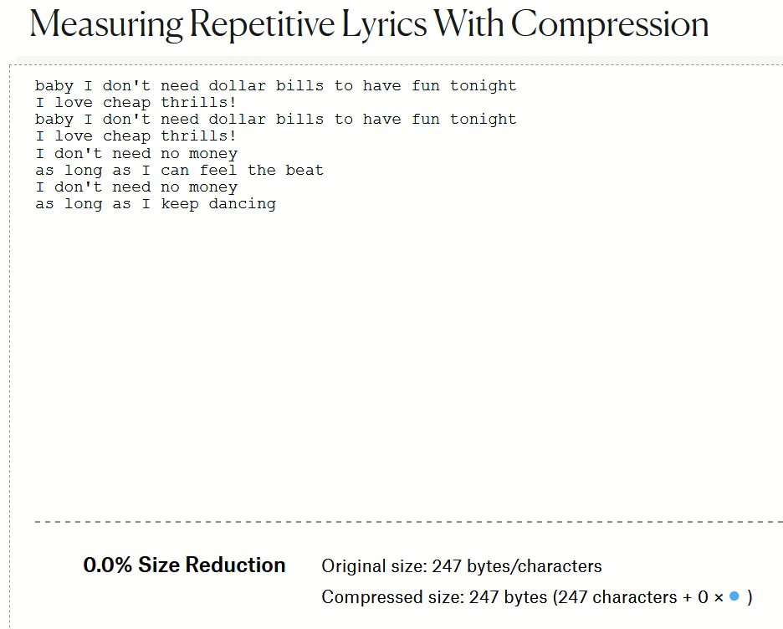
Are Pop Lyrics Getting More Repetitive?
Lempel-Zi-Welch compression measures repetitive lyric sequences.
Notes:
The Lempel–Ziv–Welch lossless compression algorithm powers gifs, pngs, and most archive formats (zip, gzip, rar...).
What does this have to do with pop music?
The Lempel-Ziv algorithm works by exploiting repeated sequences.
How efficiently LZ can compress a text is directly related to the number and length of the repeated sections.
By compressing song lyrics and comparing compression rates, repetition in lyrics can be measured.
https://pudding.cool/2017/05/song-repetition/

Slide 12
How Huffman decoding works
Encoded: 1 0 1 1 0 0 0 1 0 1 1 1 0 0
Decode
Logic:
? = next
encoded bit
8 chars × 8 bits = 64 bits compressed to 14 bits (22%)
?
1
?
1
?
1
0
0
0
S
L
O
E
L
10
O
110
S
0
S
0
L
10
E
111
S
0
S
0
Notes:
Huffman coding is a lossless data compression algorithm.
Huffman encoding assigns variable-length codes based on the frequency of characters. (The encoding process is briefly illustrated in the notes below and the algorithm is shown in the animation.)
So how is a meaningless string of encoded bits then decoded back into characters?
Decoding information (shown on the slide as a flowchart) is included along with the encoded data. The more repeated characters there are, the higher the compression.
Use cursor to walk thru flowchart, click for each letter found. i.e. 1 0 [click] 110 [click] 0 [click] 0 [click] 1 0 [click] 1 1 1 [click] 0 [click] 0 [click]
The shortest path is for the most frequently used characters, or path length is inversely proportional to character frequency.
animation of Huffman binary tree building:
http://lti.cs.vt.edu/OpenDSA/AV/Binary/huffmanCustomBuildAV.html (script is runnable but a bit broken with no titles on buttons)
To encode and decode the word "LOSSLESS" which has 2 L characters, one O, four S, and one E, copy and paste with the quotes "L,2, O,1, S,4, E,1" and click Run which is the top left button or empty square (don't press Enter), then click ( > ) Forward.
Flowchart on slide is representing a binary tree used to decode. They are functionally identical, flowcharts are for people, binary trees are a software data structure. See https://en.wikipedia.org/wiki/Binary_tree
Huffman Coding
raw text: LOSSLESS <== 8 char X 8 bits = 64 bits
charArray: L O S E <== unique chars in text
counterAr: 2 1 4 1 <== count char in text
Huff.Code: 10 110 0 111 <== variable-length binary based on frequency of characters (see above animation for encoding process)
encode: 1 0 1 1 0 0 0 1 0 1 1 1 0 0 <== substitute each char in text for Huffman code, 14 bits or 22% of original
plus charArray and counterAR to recreate binary tree
decode: 1 goes right, 0 goes down/left, stop at end node, get char, restart at top.
shortest path in binary tree for most frequent characters

Slide 13
Lossless vs. Lossy Compression
Lossless: contains all original data with redundancies removed.
    Data archives, PNG/TIFF images, FLAC/ALAC audio
Lossy: sacrifices quality for smaller file size by dropping fine-grained, subtle details from the original data
    GIF/JPG images, most audio, all video
    for end-use only, not for modification/editing
Notes:
Lossless files use compression techniques on all the data in the file.
Digital, quantitative data such as characters, numbers, and symbols is ALWAYS stored in lossless format.
Data representing qualitative properties in the analog world such as images, audio, and video can be stored as lossless (highest digital resolution of the original encoding/capture.) or "lossy" meaning resolution is reduced resulting in smaller file size. When lossless data is converted from one format to another, there is no loss in quality during the transformation. When lossy data is converted from one format to another, quality may be lost with each transformation.
FLAC = Free Lossless Audio Codec, ALAC = Apple Lossless Audio Codec.
Lossy compression first degrades the quality of original data to reduce the size, then applies compression techniques on the remaining data.
Lossy files are for end-use only, not for modification/editing which requires original data ( from lossless compression).
Creating a Lossy file from a Lossy file would introduce additional artifacts and further unnecessary information loss; always create a lossy file from the original, high-resolution source.
https://en.wikipedia.org/wiki/Lossless_compression
https://en.wikipedia.org/wiki/Lossy_compression

Slide 14
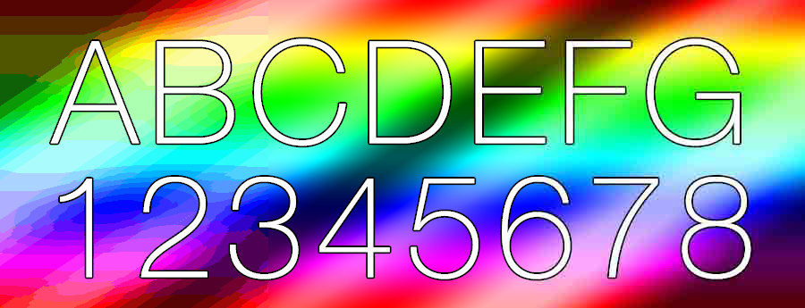
Lossy vs. Lossless compression
Lossy (GIF), 45.4kb
Lossless, 941kb
Lossy (JPG), 25.4kb
Notes:
Never give a graphic artist/designer a Lossy file.
Your eCommerce site must load quickly which means lossy compression of images but the customer likely wants to sample details which means (near) lossless files. You must balance your use of both lossy and lossless to get optimum page load performance.
All image formats have different uses and different attributes. Know exactly what image format to use for web use, print, social platforms, logos and much more with this handy cheat sheet. See https://makeawebsitehub.com/image-formats-mega-cheat-sheets/
https://kinsta.com/blog/optimize-images-for-web/
Google: optimize lossy and lossless compression for page load performance

Slide 15



MP3/AAC CD HiRes
320 kbps 1,411 kbps 9,216 kbps
22.7% 100% 653%
Notes:
High-Resolution Audio’s (HRA) bitrate of 9,216 kbps is the resolution of many recording studio masters, is nearly seven times higher than that of CD WAV files (1,411 kbps) and almost 29 times higher than that of MP3/AAC (320 kbps). The resolution of the slide images is proportional to the music formats' kilo bits per second.
The reproduction equipment and the environment where it is used determines suitability.
On the subway, with so-so earphones getting signal from a noisy, weak amplifier on the main board of your smartphone fed by a software DAC from an AAC file, it is hard to notice the difference.
In a quiet room, with excellent speakers played at concert volume by a high power amp fed by a high-quality outboard DAC,
a 24bit/96kHz source sounds like you are in the recording studio and an AAC file sounds like you are still on the subway.
Apple iTunes made a brilliant compromise on audio files:
the AAC format sounded better than MP3 at the same bitrate and file size.
AAC is now playable on Android but is guaranteed to sound worse. Fixed by purchasing an Apple product.
It sounded good enough the way most Apple users listened to their music.
The AAC file size was small enough to
a) not blow up your mobile data plan,
b) not take too long to download,
c) not fill up your iPod / iPhone,
d) allow you to make many more iTunes purchases.
Size of one hour of music:
CD/WAV: 1,411.2 kbps, 16 bit, 44.1 KHz, 635.04 MB 100% baseline
MP3/AAC: 320 kbps, 144.0 MB 23% of WAV, 7% of HRA
FLAC: lossless, about 50% of WAV or HRA native
HRA: 9,216 kbps, 24 bit, 96KHz, ~4 GB native format is 6.5 times the size of a WAV file which is why HRA is always shipped in FLAC file format.
HRA in FLAC format is ~2 GB or 327% of WAV
In one professor's HRA collection of 1,000+ files, the average size is 63 MB per file.
https://www.stereophile.com/features/308mp3cd/index.html
https://www.whathifi.com/us/advice/mp3-aac-wav-flac-all-the-audio-file-formats-explained
https://en.wikipedia.org/wiki/Vorbis describes ogg file extension
https://www.soundguys.com/the-ultimate-guide-to-bluetooth-headphones-aac-20296/
https://www.masteringthemix.com/blogs/learn/113159685-sample-rates-and-bit-depth-in-a-nutshell

Slide 16


Overview of some Compression File Formats
Data
ZIP 7z RAR
.docx .pptx .xlsx
StuffIt .tar.gz
ZIP
The Standard
Music
MP3 AAC MQA
WAV ogg FLAC
Images
GIF JPEG
RAW PNG TIFF
Video
MPG MP4 DIVX
XVID MOV AVI
BOLDed formats are Lossless.
Notes:
Data archives must be lossless. Higher quality music is lossless. Scalable images must be lossless or RAW format.
Everything else is a judgement call as to end-user requirements.
The only thing that is not a judgement call is to use ZIP archive format because every platform can read/write it.
BOLD formats in slide are Lossless. StuffIt (mac OS), .tar.gz (*nix) TAR = TapeARchive.
GIF – Graphics Information File JPEG – Joint Photographic Experts Group (IBM, Canon, other heavy hitters. Now an ISO organization.) JPEGs can have varying degrees of compression.
RAW – raw data from a camera's CCD sensor. TIFF – Tagged Image File Format, PNG – Portable Network Graphics
Music:
AAC = Apple Audio Codec which works best on Apple iPhones,
FLAC = Free Lossless Audio Codec. Neither ogg nor FLAC is supported by Apple. Both FLAC and ogg are free and open software, i.e. royalty-free. Not supporting FLAC / ogg is a marketing decision, not a technical or financial one.
WAV is the native Compact Disc (Redbook) music file often stored in FLAC format at about half the file size. (FLAC stores what is common to both left and right channels, and only the differences for left & right channels.)
WAV files as used on CDs contain music down-sampled from original analog or digital masters to 16bit dynamic range depth / 44.1kHz sample frequency which is 4X better resolution than MP3/AAC
MQA is the newest lossy encoding technique. It is a proprietary format (think royalties) which can deliver HiRes Audio with about twice the file size of CD WAV but 60% of the size of 24BIT/96kHz file with little noticeable loss in quality; data is stored in FLAC format; used by HiRes streaming services.
Many of these formats use Lempel–Ziv–Welch and/or Huffman Coding.
Note: MS-Office 2007+ files are compressed when saved as .docx, .pptx, .___x formats. Open with 7zip to inspect contents.
Additional file compression into a 7zip file proper yields a little extra compression but not much.
Software that utilizes any Music, Video, Image file formats (e.g. VLC) has a built-in decompression function so the data can be used (e.g. as a temporary, uncompressed workfile/stream) and a compression function when the data is saved.

Slide 17
Drawbacks to Compression
Time: compression needs CPU and primary storage resources
  PCs have lots of both and only one user. Servers on the other hand…
Space: archived files must be uncompressed before use,
extra space needed for both compression & decompression
Integrity: any data corruption can cause loss of entire archive
  Solid or multi-volume archives can be lost with even minor data corruption. Archive repair is possible but not probable.
  Test your archives to confirm integrity.
Recoverability: the Lossy sacrifice is reduced quality
  Some data is lost after Lossy compression (hope you don't notice)
Notes:
Increases in transmission latency over TCP/IP can reduce throughput significantly.
E.g. from 93.5 Mbps to 16.2 Mbps with 30ms latency or 17% of a zero latency connection.
http://smutz.us/techtips/NetworkLatency.html
SPACE: in addition to the archive’s space, you need space for the unarchived & uncompressed files to be extracted before they can be used. Double clicking on a file within a ZIP archive extracts the file to a temporary area before it is opened. Files with compression built into the software that reads them still require memory or temp work files.
Integrity
Standard compression compresses the individual files, and then archives them into a single file. Data corruption may affect only a single compressed file, not the entire archive, however special zip file recovery tools will be needed and recovery of one, some, or almost all files from a corrupted archive is more about luck than technology.
In a solid archive, all files are first archived into a single data block and then compressed. It is more efficient because compression of redundancies occurs across all data in all files instead of within individual files. However, it makes recovery very difficult, if not impossible, in cases of corruption. https://en.wikipedia.org/wiki/Solid_compression
There is the "potential for corruption" for anything in storage regardless of format. The issue with archives is their data is usually unrecoverable with any data corruption whatsoever -- even a single bad bit can compromise the archive's integrity and all data can be lost. Even if repair is possible, some data will always be lost. Whereas, if a simple text file had a single bad bit, it would corrupt only a single character within the file.

Slide 18
Why do we need backups?
2/3 to 3/4
of all
data loss
Accidental deletion by users including IT people
Hardware failure: all storage devices eventually fail
  Less Frequent Causes
    Ransomware infection
    Catastrophe: fire, flood, theft, loss
    SQL injection attacks
    cloud provider's business failure or
    account closed on cloud system.
Notes:
Note: servers always have UPS systems to guard against power failures – surges – brownouts. UPS allows for orderly server shutdown to prevent systems crashing upon power loss. Many servers also have redundant internal power supplies.
All storage devices will eventually fail, especially mechanical drives. Even solid state devices wear naturally with age and more so with high write cycles (program/erase cycles). See https://www.dell.com/support/article/ca/en/cadhs1/sln156899/hard-drive-why-do-solid-state-devices-ssd-wear-out?lang=en
https://www.howtogeek.com/322856/how-long-do-solid-state-drives-really-last/
https://www.researchgate.net/publication/273398289_Soft_Failures_in_Large_Datacenters
https://en.wikipedia.org/wiki/Data_corruption
https://en.wikipedia.org/wiki/Data_degradation
https://electronics.stackexchange.com/questions/27455/how-often-does-bit-rot-occur
https://www.datamation.com/cloud-computing/slideshows/top-10-cloud-computing-failures.html

Slide 19
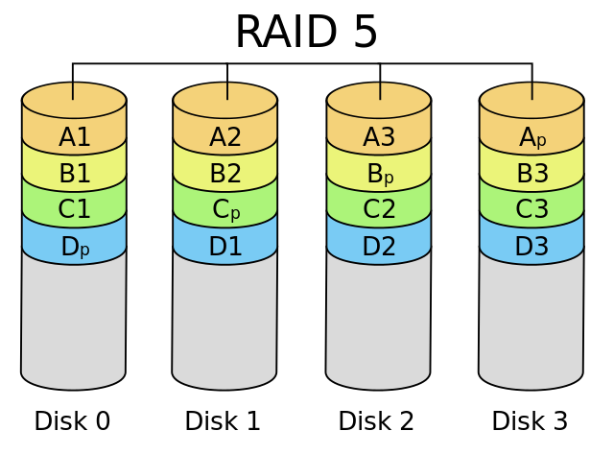
Continuous Data Integrity with RAID
Redundant Array of Independent Disks
RAID 5 or 6 tolerates failure of 1 or 2 drives
RAID 5 needs +1 drive for parity, RAID 6 needs +2 drives
RAID appears as one logical drive to OS.
Provides increased read/write performance with multiple spindles doing parallel I/O
Notes:
RAID provides for continuous data integrity in case of storage failure. (RAID is not backup.) One (or two with RAID 6) drives can fail without system operations or data integrity being compromised. There is reduced overall I/O performance in case of drive failure but no catastrophic loss as there would be without RAID. OS is alerted that a RAID drive has failed and hardware maintenance is required. System operator / IT Administrator should monitor for these alerts.
Note that RAID is usually a hardware level feature of the disk storage controller., the OS mounts this secondary as a single logical drive – the OS is unaware that the drive it sees is an array of physical drives. RAID requires multiple IDENTICAL drives; allows hot swapping in case of a failed drive. Some *nix systems have a software level RAID feature built into the OS which does not require a hardware RAID disk controller.
A file’s data is “striped” across three drives. A parity value is calculated and written to the fourth drive (minimum three drives needed).
The operating system/RAID controller does performance and space balancing across the drives when stripes are written.
In the event one drive is lost, simple arithmetic can calculate the missing stripe. There is a performance penalty after a disk loss but not a data loss. The OS issues a message to the sysop that a RAID drive has failed. Call the service technician…The bad drive is hot swapped out and the operating system/RAID controller rebuilds the new drive when the service technician activates the replacement drive.
Servers also have a variety of redundancies to avoid other hardware issues, e.g. dual power supplies, UPS power conditioning systems, Error-correcting code memory (ECC memory).
Mainframes can have redundant array of independent memory (RAIM).
Small and personal systems use RAID-1 for data protection. Each drive is mirrored by a twin drive. Raid-1 mirroring, Fault Tolerance: n − 1 drive failures, requires 2X drives
RAID 5 consists of block-level striping with distributed parity. It requires that all drives but one be present to operate. Upon failure of a single drive, subsequent reads can be calculated from the distributed parity such that no data is lost. RAID 5 requires at least three disks. Fault Tolerance: 1 drive failure, requires minimum 3 drives– n with data, 1 with parity. E.g. Data1=3, Data2=2, Parity=5. Lose 1 (5 – 2 = 3). Lose 2 (5 – 3 = 2). Lose Parity, still have original.
https://www.thegeekstuff.com/2010/08/raid-levels-tutorial
https://en.wikipedia.org/wiki/Standard_RAID_levels
In computer storage, the standard RAID levels comprise a basic set of RAID (redundant array of independent disks) configurations that employ the techniques of striping, mirroring, or parity to create large reliable data stores from multiple general-purpose computer hard disk drives (HDDs). The most common types are RAID 0 (striping), RAID 1 and its variants (mirroring), RAID 5 (distributed parity), and RAID 6 (dual parity). RAID levels and their associated data formats are standardized by the Storage Networking Industry Association (SNIA) in the Common RAID Disk Drive Format (DDF) standard.[1]
While most RAID levels can provide good protection against and recovery from hardware defects or defective sectors/read errors (hard errors), they do not provide any protection against data loss due to catastrophic failures (fire, water) or soft errors such as user error, software malfunction, malware infection. For valuable data, RAID is only one building block of a larger data loss prevention and recovery scheme, it cannot replace a backup plan.

Slide 20
User Level File Recovery … is not backup
Windows File History, macOS Time Machine are not backup
Automatic copying of files to external or network drive
Historical versions of user files maintained. Easy to restore.
Must configure and test to ensure copying of all user folders.
  If drive is always connected, it is not a backup, just a copy; it is likely
  not geographically separate and certainly not platform independent.
Windows Recycle Bin, macOS Trash can are not backup
Only good for oops! and short-term recovery.
  The bin/trash is not a reliable copy much less a backup.
Two-way synchronization is not backup
  Synchronization is platform interdependent, not independent.
  A file on one system does not have a "copy" on other systems,
  the same file co-exists on all synchronized systems.
Notes:
If drive is always connected, it is not a backup, just a copy – i.e. neither geographically separate nor platform independent.
http://www.pcworld.com/article/2974385/windows/how-to-use-windows-10s-file-history-backup-feature.html
By default, Windows 10's File History will back up all the folders in your User folder. If you also want other folders backed up, you must configure it. This is an issue in corporate environments – do you have enough control over where users save their files? Are you always consistent about where you store your own data? File History is for user data recovery, not system recovery.
Apple macOS Time Machine backups up everything. An entire system can be recovered. It automatically makes hourly backups for the past 24 hours, daily backups for the past month, and weekly backups for all previous months. The oldest backups are deleted when the external backup drive is full. Time Machine uses a Full & Differential & Incremental backup strategy. https://support.apple.com/en-ca/HT201250
Trash / Recycle Bin can be emptied – files are gone. If the Bin/Trash is full, new deletions push out oldest deletions.
Low-level utilities can be used to recover only in extraordinary circumstances.

Slide 21

A copy in a geographically separate location that is platform independent.
Notes:
https://en.wikipedia.org/wiki/Backup
a copy -- just because the cloud backs up your data doesn’t mean a) the cloud cannot mess it up, b) you won’t accidently delete it, c) the cloud service will always be there.
in a geographically separate location – if the building burns down or your machine is stolen, your external HDD backup drive is going with it.
that is platform independent. OneDrive or Dropbox or Google Backup & Sync (there is a reason they differentiate between Backup and Sync) or anything that does two-way synchronization with your system is not platform independent, it is platform inter-dependent. If the synch software gets confused, it does not know which is good and which is bad. The GOOD version may end up synced to look like the BAD version. This is known as the Byzantine fault tolerance problem. A Byzantine fault is any fault presenting different symptoms to different observers. A failed node can generate arbitrary data, pretending to be a correct one, which makes fault tolerance difficult. https://en.wikipedia.org/wiki/Byzantine_fault_tolerance#Background
Backup Stories
" I need an extension. My work was backed up to a USB drive that I left beside my laptop. When I came home, the house had burned down."
"Data backed up to husband's computer which was located across the room. Thieves broke in and stole ALL the computers. Two weeks later, it would not have mattered. Apartment in New Orleans was underwater after Hurricane Katrina."
"Had complete backup in external drive which was in backpack with laptop. Backpack was stolen."
" I had a big problem going to a customer in Brazil. I was going to attend a meeting with all the Bayer regional managers. Some managers came from other cities. It was a big event and I was responsible for the GIS presentation. Before leaving home, I had a presage. Some angel made me come back and made a backup on a cd disk. I was robbed on the way and someone took my notebook. "
Ransomware will encrypt both live and backup files stored on the same platform. There may be copies in a remote Network-Access-Storage system but if it is not platform independent, the ransomware can see it. This happened to a CDN company in July, 2017 and the ransom paid was $425,000.
Another scenario: two machines running Windows 8.1 synced to OneDrive and, via OneDrive, synced to each other. One is a backup of the other? Wrong. Not platform independent. Performed a Windows 10 upgrade on one machine…a week’s work to undo the disaster: 4,857 files found in Recycle bin, >5,000 disappeared files restored from backup or the Windows 8.1 machine only because, fortunately, the OneDrive synch service stopped.

Slide 22
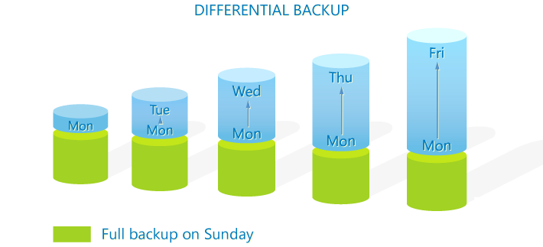
Classic File Backup Types/Strategy
Full + Differential (only files changed since last Full backup)
Full backup is slow, Differential backup is faster but gets slower.
Restore from Full + Differential is fastest.
Notes:
Full + Differential and Full + Incremental are strategies used to backup to tape.
A Full backup of all files takes time and usually requires exclusive use of the system.
How does system know which files are to be differentially backed up? Server quality backup software maintains catalogs of all previous backups and compares the current files' date/timestamp, size, CheckSum to the backup catalog's.
Simple PC backups: full and differential can be created with zip utilites such as 7zip and WinRAR which compare the date/timestamp and size of current files to the files in the Full backup.
Google backup utilities using 7zip
https://portableapps.com/apps/utilities/toucan -- makes the process easier
http://www.techradar.com/news/software/10-essential-tools-for-backing-up-and-protecting-your-pc-1284497
https://www.codetwo.com/admins-blog/difference-differential-incremental-backup/
Differential Pros:
The process is much quicker than a full backup since it only takes a copy of what was changed with reference to the Full backup.
The backup copy itself takes far less storage space than when a full copy is created each day.
Cons:
The size of the data differences part grows with each cycle. If the cycle is long (e.g. the full backup is performed once a month and the differential is taken every day), at the end of it the size of the archive might be quite big and the process itself pretty lengthy.

Slide 23

Classic File Backup Types/Strategy
Full + Incremental (only files changed since last backup)
Full backup is slow, Incremental backups are much faster than Diff.
Restore from Full + Incremental sets is slowest.
Restore from Full + Differential is fastest.
Notes:
How does system know which files are to be incrementally backed up? Server quality backup software maintains catalogs of all previous backups and compares the current files' date/timestamp, size, CheckSum to the backup catalog's.
A simpler method is checking the Archive bit which is set by OS whenever file is changed in any way. The Archive bit is set off when the file is backed up, and set on when the file is changed. WinRAR can use the Archive bit in this way. 7zip cannot – 7 zip would require an intelligent PowerShell script to accomplish this.
Backup Types: full and differential can be created with zip utilites such as 7zip and WinRAR.
https://www.codetwo.com/admins-blog/difference-differential-incremental-backup/
Incremental Pros:
The backup process is even faster than the differential job, not to mention the full backup. It is, in fact, so fast that it can be performed every hour or even minute.
Each iteration of the backup job copies just the data that was changed. Therefore, only a small amount of storage is required each time.
Cons:
In most cases, the backup/restore software requires all iterations of the incremental backup for data restoration. If one of the pieces is missing – the restore is impossible.
The restore process might take some time as the software needs to rebuild data from separate incremental pieces and also the last full backup piece too.
Classic File Backup Schedule
Month-end: Full backup, retained for 2 years
Weekend (Sunday): Differential backup, retained for 2 months (Differences since last Full)
Daily (Monday – Saturday): Incremental backup, retained for 2 weeks (changes since last backup of any type)

Slide 24
Enterprise backup
Backup software manages Full, Differential, Incremental strategies
  Options for file versioning (retaining file generations)
  Journal snapshot, DB duplication for continuously running systems.
  Checkpoint processing with save-while-active on IBM Power
LTO tape or Optical Disc libraries as nearline tertiary storage
AWS Glacier, Google Nearline, Sync cloud cold storage
  Inexpensive backup storage but expensive and slow restore
Recovery and Restoration speed is highly variable.
  Depends on data transfer rates from backup to server and complexity of rebuilding the relational aspect of data base objects
Data deduplication and Single-instance optimize storage
  eliminate duplicate copies of data within and across systems
Notes:
GoodSync or Bareos are examples of backup software which maintains a DB of the server's file system and what was backed up; when it runs, it compares the requested backup type (Full, Diff, Incr) for files currently in the server to its DB of previous backups.
Tertiary storage is cold storage: safely offline but accessible...in a while from now.
Secondary storage is:
- online drives, SAN, high-performance cloud.
- Hot storage for databases, transactional business data (e.g. debit/credit cards, banking), frequently read data, frequently changed data (AKA volatile).
- Warm storage is file serving, NAS, standard cloud IaaS.
Primary storage is RAM.
https://phys.org/news/2018-03-golden-next-gen-optical-disk-storage.html
https://www.google.com/search?q=cloud+hot+warm+cold+storage
Any cloud storage should be “Zero-knowledge”, i.e. encrypting and decrypting data is purely client-side.
See https://www.cloudwards.net/online-storage-vs-online-backup-whats-the-difference/
Two-way cloud sync is not backup, it is synchronizing two (or more) systems via the cloud to keep data on all systems the same. A synchronized file is not a copy, it is the same file co-existing on different systems. Because one system can change the other (for better or worse), there may be no way to recover from data loss or to return to a previous version of a file. If a file is accidently deleted or improperly synchronized, it will be done in both locations. A backup isn’t a backup if it changes dynamically with the original file. Although, some cloud sync services maintain versioning and permanent storage of deleted files – this is highly recommended.
Cloud backup services often have hidden bandwidth throttling. The initial full backup could take as long as weeks to complete. After that, incremental backups are practical. Is the service's restore similarly throttled? Can you download all your data in a practical length of time?
https://www.forbes.com/sites/tonybradley/2013/07/23/the-myth-of-online-backup/#324bd3adef49
http://revuezzle.com/cloud-backup/cloud-backup-articles/news2/faster-backup-carbonite-cuts-throttling/
Top 7 Risks of Cloud File Sync & Share
https://marketplace.mobileiron.com/servlet/servlet.FileDownload?file=00P3400000hF9ynEAC
https://www.zdnet.com/article/why-cloud-sync-not-backup-worked-better-for-business-continuity-during-the-hurricane/
https://www.zdnet.com/article/when-it-comes-to-cloud-storage-the-all-you-can-eat-buffet-is-closing-rapidly/
https://www.zdnet.com/article/ultimate-guide-to-gmail-backup/

Slide 25
3-2-1 Backup Checklist
3 copies (change only the active file, not the backups)
  1 active, 1 local backup, 1 remote backup
2 different formats/platforms (platform independence)
  External drive is platform independent only when not plugged in
  LTO tape or optical disc. Initially local, optionally moved offsite.
  One-way backup to cloud cold storage (not two-way cloud sync)
1 off-site backup (geographically separate location)
  Cloud storage different from your cloud IaaS, PaaS, SaaS provider
  tape/optical media – rotate Full, Diff, Incr offsite storage services
The near loss of Toy Story 2
Notes:
2 different formats/platforms: do not make copies on the same technology or platform. If the tech fails or system is compromised, you may lose both backups.
A fire proof safe is somewhat in between a local copy and a geographically separate location: It is not likely to be stolen and might survive a disaster. (but see next slide)
Simple small business: rotate external drive from office to home, or home to vehicle.
media rotation and storage services, e.g. Iron Mountain
https://www.ironmountain.ca/en/secure-storage/records-and-media/offsite-tape-vaulting
https://www.ironmountain.ca/en/digital-transformation/iron-cloud-data-management
3 – local files on server,
2 – traditional full/incremental backup to LTO tape, e.g. with Duplicity https://en.wikipedia.org/wiki/Duplicity_(software)
1 – cloud backup, e.g. with Restic which uses deduplication. https://restic.net/ https://en.wikipedia.org/wiki/Data_deduplication
https://www.backblaze.com/blog/the-3-2-1-backup-strategy/
https://www.backblaze.com/cloud-backup.html
https://www.backblaze.com/blog/backing-linux-backblaze-b2-duplicity-restic/
https://www.cyberciti.biz/open-source/awesome-backup-software-for-linux-unix-osx-windows-systems/
https://help.ubuntu.com/community/BackupYourSystem
http://windowsitpro.com/blog/why-3-2-1-backup-rule-still-makes-sense
https://www.youtube.com/watch?v=8dhp_20j0Ys
https://www.petri.com/windows-server-essentials-file-history
https://www.pcmag.com/roundup/353619/best-cloud-backup-services-for-businesses
Toy Story 2 almost disappeared. 2 ½ minute YouTube.
https://www.youtube.com/watch?v=8dhp_20j0Ys

Slide 26
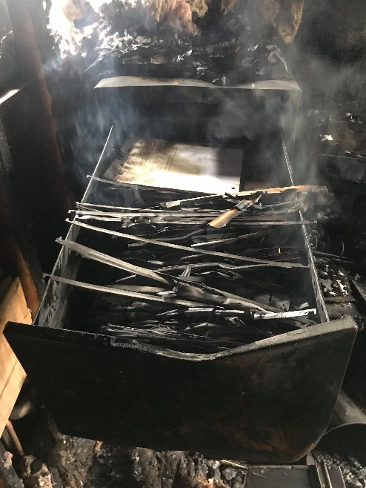
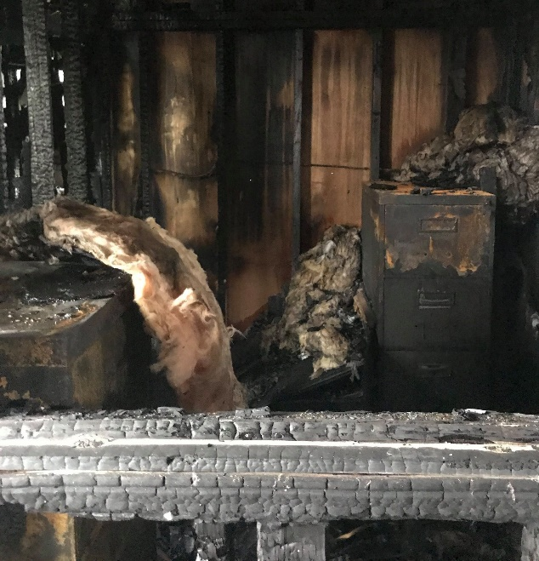
The final word on backups…
Backups do not matter.
Only RESTORE matters.
Notes:
Backups are something we all hope we never have to use. But they are useless without a restore plan and might not have all you need without restoration testing.
Restoration of a large amount of data over a network, especially a cloud service, will be slower than a direct attach device or NAS. Many cloud services throttle I/O, i.e. up and download speed. The speed of the restoration must be considered.
From Toronto, you can fly to Vancouver or drive to Vancouver or walk to Vancouver; all are possible, only one is practical.
The same goes for restoration of data: it must be possible and practical (speedy and cost effective).
Photos of office ruined by fire that started in the building across a parking lot. The business in that office, with a high eight figure revenue, belongs to a builder of single family homes who builds them a subdivision at a time. (Tim McKenna's brother-in-law)

Slide 27
NOTES
…not on the quiz but here for further information and explanation.

Slide 28
Compression file formats
JPG, PNG, GIF, TIF / TIFF, TGA
Compression formats used by the graphics industry
MP3, WMA, MP4, MQA, WAV, FLAC
Compression formats used by the sound engineering and music industry
MPG, MP4, DIVX, XVID, MOV, AVI
Compression formats used by the video industry
Notes:
Windows Paint can open and save to some of these graphics formats
Windows Media Player can open many of these music & video formats
Most of these are lossy formats, thus cannot be uncompressed to original source data.
PNG and TIFF are lossless graphics formats.
FLAC – Fully Lossless Audio Codec – is lossless but is usually a container for WAV (Redbook, 44K

Slide 29
How Compression Works
Here is an old quote from Vangie Beal:
  Data compression is particularly useful in communications because it enables devices to transmit or store the same amount of data in fewer bits. There are a variety of data compression techniques, but only a few have been standardized. The CCITT has defined a standard data compression technique for transmitting and a compression standard for data communications through modems. In addition, there are file compression formats, such as ARC and ZIP.
This quote contains 449 characters.
Notes:
Info on this and the next two slides are reproduced within the activity.
Note that this is a conceptual explanation of compression. Lempel–Ziv–Welch is a sophisticated mathematical process that works on binary data.
http://www.webopedia.com/TERM/D/data_compression.html

Slide 30
How Compression Works (cont’d)
Replace “compression ” with "♠". The text becomes:
  Data ♠is particularly useful in communications because it enables devices to transmit or store the same amount of data in fewer bits. There are a variety of data ♠techniques, but only a few have been standardized. The CCITT has defined a standard data ♠technique for transmitting and a ♠standard for data communications through modems. In addition, there are file ♠formats, such as ARC and ZIP.
With dictionary “♠compression˽” and 5 replacements,
total size is 406 characters, 90.4% of 449.
algorithm builds a token/string dictionary
Notes:
replacing symbols with new, weighted symbols based on frequency of use. i.e. it must be used at least twice for any benefit.
Original = 449 char
“Compression” is 11 characters X 5 occurrences = 55 char saved
But 5 symbols must be used, saved 50 char net
And 1 dictionary entry is needed 1 symbol + 11 characters, saved 38 char overall

Slide 31
How Compression Works (cont’d)
With more pattern matching and a bigger dictionary… ♠compression˽ ☻transmit ♣here are˽ ♥data˽
♦communications˽ ☺standard˽ ♪technique
  ♥♠is particularly useful in ♦because it enables devices to ☻ or store the same amount of ♥in fewer bits. T♣a variety of ♥♠♪s, but only a few have been ☺ized. The CCITT has defined a ☺♥♠♪ for ☻ting faxes and a ♠☺ for ♥♦through modems. In addition, t♣ file ♠formats, such as ARC and ZIP.
Including dictionary, total size is 363 characters or 81% of original. The more pattern matches there are for each dictionary item, the higher the compression.
Notes:
Put the quote into a simple .txt file and compress the binary values into a .zip file…
From 451 char (449 + CR/LF) to 244 char or 54%.

Slide 32
Two types of Compression Formats
Loss-Less
.
ZIP, TIF, FLAC, and other general file compression routines are considered lossless compression. The original data is completely encoded; compression reduces redundant data (e.g. a large blank space in a TIFF image or a long noiseless passage in FLAC audio).
The data is always complete; after decompression, no one would be able to determine that the data was compressed, it’s all there and useable.
Lossy
  JPG, MPG, MP3, GIF, and other end-user formats use lossy compression. Data is removed from the original in order to achieve compression. You can not return to the original uncompressed file.
    GIF images reduce the number of colours in an image
    JPG images effectively delete colour information to achieve compression
    MP3s simplify the sound waves of audio
  Developers can adjust the amount of compression and quality content

Slide 33
What is “Lossless” Vs. “Lossy” Compression? (Cont’d)
JPG, MPG, MP3, GIF, and other formats use lossy compression.
These formats, in order to achieve compression, remove data from the source file:
  GIF images limit the number of colours in an image to 256 per pixel but preserve detail with lossless data compression similar to ZIP files. Useful for sharp-edged line art.
  JPG images delete colour and fine detail information to achieve compression with acceptable reproduction of photographs.
  MP3s simplify the sound waves of audio.
A file with Lossy compression can never be returned to its original, complete state.
The amount of loss or compression can be adjusted; a developer decides how much compression can be applied while retaining enough useful quality of the content for the intended purpose. E.g. high compression for JPG thumbnail images but little compression for large, zoomable images.

Slide 34
Overview of some Compression File Formats
ZIP:
  The most popular general-purpose compression archive.
  Supported on virtually all platforms from mainframes to PCs.
  Includes features such as encryption using password protection.
RAR, 7z, TAR, StuffIt:
  Proprietary general-purpose compression file formats with incremental improvements over Zip but with the loss of standardized support.
  use different algorithms, with various benefits and uses.
  Some are designed for different operating systems
  (StuffIt for Mac, TAR for *nix--TapeARchive).

Slide 35
Overview of some Compression File Formats (Cont’d)
GIF, JPG, PNG, TIFF:
  These are compression formats used by the graphics industry.
  GIF and JPG are lossy formats and cannot be uncompressed to the original source data.
MP3, MP4, OGG, FLAC, MQA:
  These are compression formats used by the sound engineering and music industry.
  These are lossy formats – except FLAC - Fully Lossless Audio Codec – and cannot be uncompressed to original source data.

Slide 36
Overview of some Compression File Formats (Cont’d)
MPG, MP4, DIVX, XVID, MOV, AVI:
  These compression formats are used by the video industry.
  These are all lossy formats.
  These will often mix compression algorithms from audio and image. technologies.

Slide 37
What is a “Backup” and why do we need backups? (Cont’d)
Backup is the “procedure for making extra copies” of data “in case the original is lost or damaged and must be restored.” The procedure includes storing the copy in a geographically separate location which is platform independent from the original file and host system.
Having a backup will allow you to recover from lost, broken or stolen hardware, and from your own accidental deletions.
You should be in the habit of backing up user created files on your laptop or PC. OS and apps can be restored from their original software providers or a system Restore Point but user created data can only be restored from backups.

Slide 38
When & How to run your Backup
Automatically:
  Performed by continuously running backup software that constantly monitors for file changes. Used for Full and Incremental strategy.
Scheduled:
  system operator or backup software runs a backup at specific times, such as overnight, when it has the least impact on business operations or at critical business times such as at accounting month/year end. Used for Full, Differential, and Incremental strategy.
Manual Backup:
  a user performs backups at their own convenience. Not a strategy.
  It is the least effective method (what if you forget to do it?), but it’s better than no backup at all!

Slide 39
Locations of Backup Media
Local:
  copies files to a drive in use by the system.
  fastest and most convenient, but if the computer is lost or malfunctions, so goes the data! Just having a copy is not a backup.
  Local copies may be made to reduce downtime. The copies are then moved to External media or transmitted which is a slower process.
External:
  Copies files to External/Portable/Flash Drive.
  i.e. a device which can be disconnected from the computer.
  It is a backup when the platform independent device is taken off-site.

Slide 40
Locations of Backup Media (Cont’d)
Network:
  Back up files to the cloud (Google Drive, OneDrive, Dropbox, iCloud)
  It is a slower option for large backup. Cost effective communications bandwidth has significantly less throughput than writing data to a directly attached device.
The best location depends on the type of work you’re doing, the volatility of the data (how quickly it changes), the volume of data, the backup window (available downtime), security considerations, and the speed/availability of restoration.

